Slide 1
Document Design and Visual
By: Khai, Akshat, Gireesh, Colver and Luqman

Slide 2
Table of Content
Outlining
Paragraphing
Paragraphing Structure
Sequencing
5 W's about Visual
Visual in Graphs, Charts, Graphics Illustration and Computer Graphic
How to Avoid Visual Distortion
How to Incorporate Visual with Text
Page Design in Workplace
Page-Design Guidelines

Slide 3
Outlining
Steps to create a meaningful paragraph
Choose a topic (Topic Arrangement)
Gather Material (sources) (Outlining)
Simplify the information from the sources, in which understandable for you (Paragraphing)
Justify it to make sense for reader (organize pattern) (Paragraphing) (Sequencing)
Make sure to follow the guides of “Typical Questions in Organizing for Reader”? (Sequencing)`

Slide 4
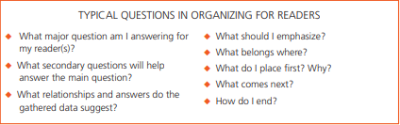
Outlining
Notes:
Lannon, John M., et al. “Chapter 11 Organizing for Reader.” Technical Communication, Pearson Canada, 2018, pp. 168–168.

Slide 5
Paragraphing
Any piece of text in the world, including all kind of text, must and have to follow this layout
Beginning Sentence/Paragraph
Background Information of Topic (if required)
Central Section (Body Sentences/Paragraphs)
Conclusion Sentence/Paragraph

Slide 6
Paragraphing
Technical Report Arrangement
The Reason of the Report (Beginning)
The Report’s conclusion (Central Section)
The Report’s recommendations (Central Section)
Main Challenges when solving the issue (if any) (Conclusion)

Slide 7
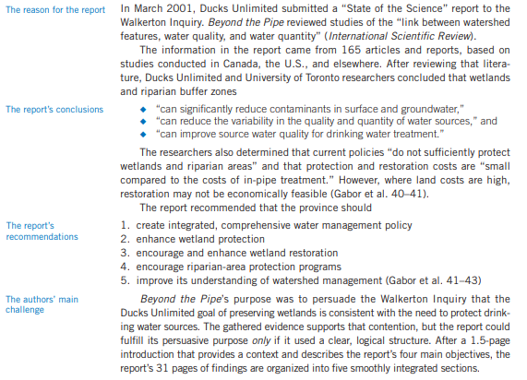
Paragraphing
Notes:
Lannon, John M., et al. “Chapter 11 Organizing for Reader.” Technical Communication, Pearson Canada, 2018, pp. 170–170.

Slide 8
Paragraphing Structure
Beginning:
The most important part decided whether the reader will continue to read the rest of the report or not.
Explain the topic’s significance issue and document’s purpose, identify who is the audience group.
Account for any limitation (uncomplete or questionable data).
It has to be short so reader can have a quick look and decided if they want more information or not.

Slide 9
Paragraphing Structure
Central Section:
Can have one paragraph or multiple paragraph (depends on the complexity of the problem)
Reveal all the problems, including statistics, recommendations and solutions
Each paragraph should only handle one problem + one solution (if applicable)
Be clear and concise about the issue, stay into the topic all the time

Slide 10
Paragraphing Structure
Conclusion:
Re-Emphasize the Key points
Offer a solution, recommendation
Predict an outcome and suggest if the case is not finish
Recall the reader about the whole main ideas of the essay

Slide 11
Paragraphing Structure
The Standard Paragraph:
Usually begin with a topic sentence (in rare case, might be 2)
Develop the topic sentence using proof, statistics, fact, etc,.
Pretend that you are a professional in that area or a person who knows the situation well
Try not to go beyond the answer that reader is looking for
Pay cautions to cultural style of writing

Slide 12
Paragraphing Structure
The Topic Sentence
Must be clear and detailed
Give reader a sense and what to expect about this paragraph
Unclear Topic Sentence = Mislead the paragraph
Alternative Topic Sentence Place
Sometimes at the end of the paragraph
Sometimes placed in the 2nd sentence. 1st sentence is the transition sentence between the previous one and this one (if related)

Slide 13
Paragraphing Structure
Paragraph Unity
Directly support the topic sentence, word in the topic sentence get repeated many times throughout the paragraph

Slide 14
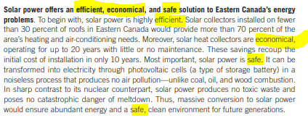
Paragraphing Structure

Slide 15
Paragraphing Structure
Paragraph Coherence
Each sentences linked the paragraph together to support the topic sentence
Many transition words used throughout the paragraph
Sequencing must be in order

Slide 16
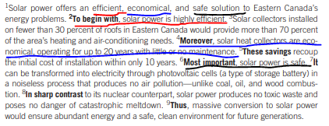
Paragraphing Structure

Slide 17
Paragraphing Structure
Paragraph Length
Make it as simple as you can
Not too short (less than 100 words) or too long (more than 300 words)
Some exception applied if exceed 300 words: issue is too complex, too many important key points and ideas

Slide 18
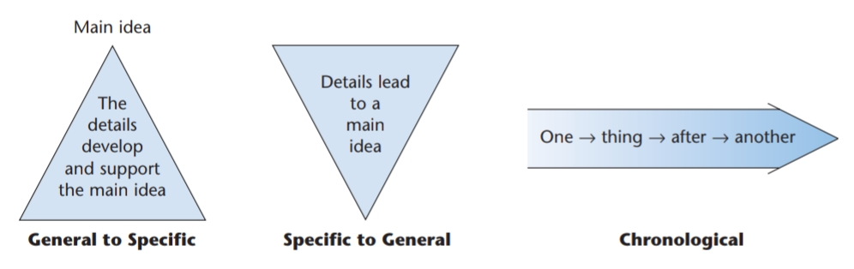
Sequencing
The flow of a story, make it logical

Slide 19
Sequencing
General to Specific
Spatial Sequence: Begins at one location and ends at another, most common example is describing an object, throughout its details
Statement plus Illustration: Story that is too complex to describe so an example or similar situation will be given to clarify the ideas. Topic Sentence addressed the issue and the rest use to draw an image for reader to imagine

Slide 20
Sequencing
General to Specific
Emphatic Sequence (Statement plus detailed evidence or arguments): Statement which arrange the order of importance of reasons or examples for an issues
Extended Definition: Descriptive pattern used to organize a paragraph, piles up the details to help reader understand a term

Slide 21
Sequencing
General to Specific
Classification: Close examination of any complex issue require both partition and classification. Usually give the ideas as point form
Comparison - Contract Sequence: Similarities and Difference between two or more issue/solution. Followed by Similarities and Differences from the first one to next one

Slide 22
Sequencing
Specific to General
Begin with the detailed problem or solution and concluded that using a topic sentences
By the time reader get to topic sentence, they already figure out what is the problem

Slide 23
Sequencing
Chronological
Narrative Sequence: Brief description of what was happening, make sure to use words involved with step describe such as first, at that level, then, etc,.
Instruction: Guides on how to do something or how something happened in a short period of time. Must use words such as first step, second step, third step, etc,.

Slide 24
Sequencing
Chronological
Process Description: A guide of what was or will be happened of a certain act that is already known
Problem - Cause - Solution Sequence: Going from descriptive of the problem, then analyze the cause and recommended a solution to the problem

Slide 25
Sequencing
Chronological
Cause - Effect Sequence: Begin with the cause of the problem and then concluded the effect of that. Topic Sentence is the cause and the rest is Effect
Effect - to - Cause Sequence: Inverted of Cause - Effect Sequence, usually happens when there are too many Effect from a solution or problem that need to be addressed first before explain the cause from it

Slide 26
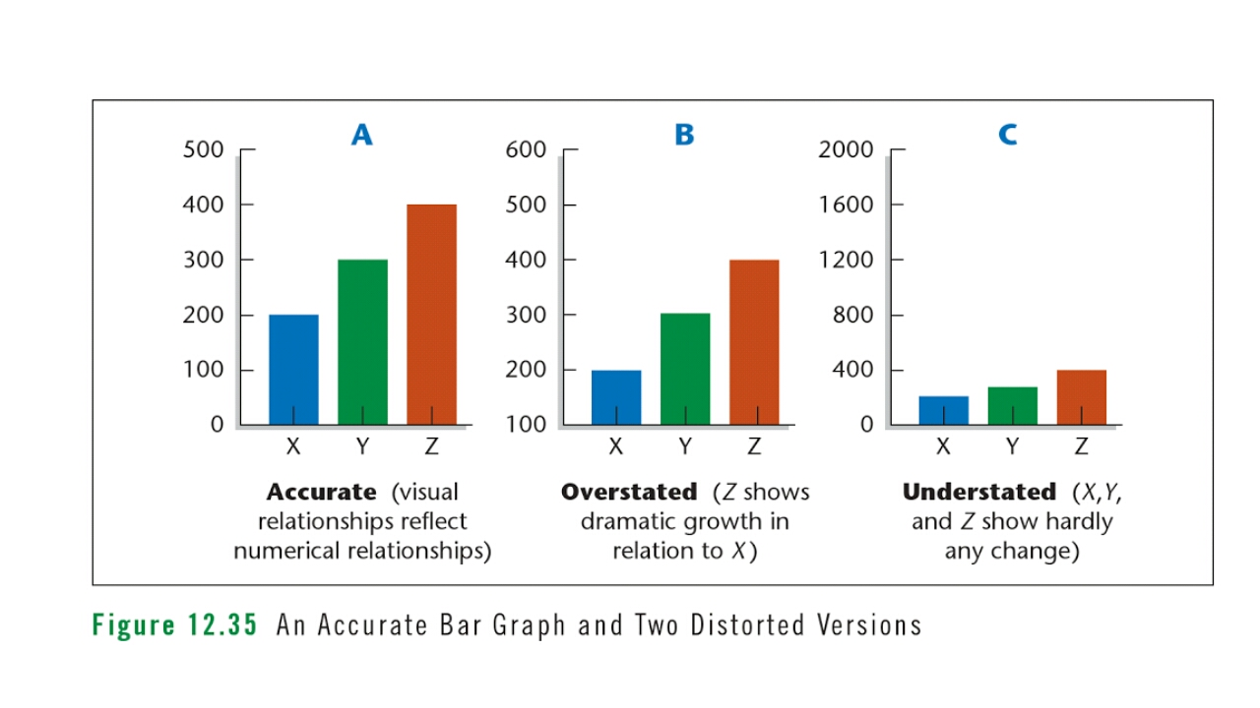
How to avoid visual distortion
Present the Real Picture

Slide 27
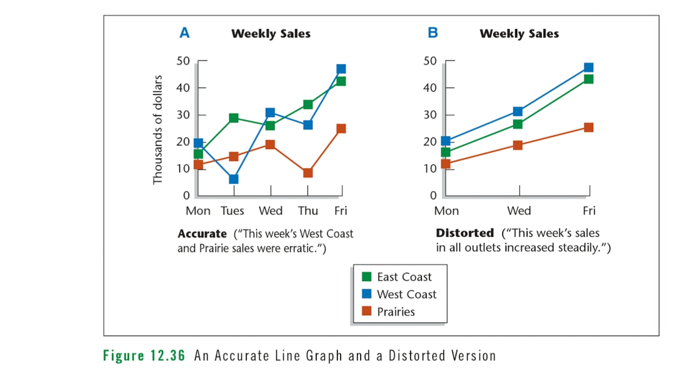
2. Present the Complete Picture

Slide 28
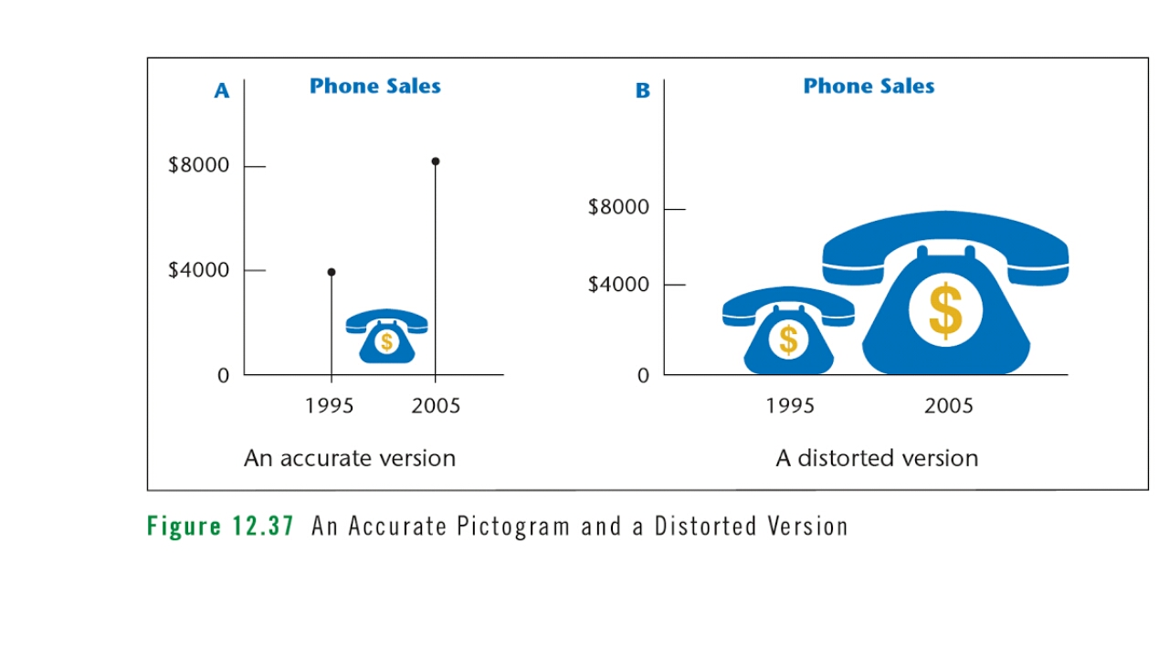
3. Never Mistake Distortion for Emphasis

Slide 29
How to incorporate visuals with the text
Visual and verbal element guidelines:
Place the visual where it best serves your readers
Never refer to a visual that readers cannot easily locate
Never crowd a visual into a cramped space
Number the visual and give it a clear title and labels
Match the visual to your audience
Introduce and interpret the visual
Use captions to explain important points made by the visual
Never include excessive information in one visual
Be sure the visual’s meaning can stand alone

Slide 30
Checklist for evaluating visuals
Content:
Does the visual serve a legitimate purpose (clarification, not mere ornamentation) in the document?
Are all patterns in the visual identified by label or legend?
Do the visual relationships represent the numerical relationships accurately?
Placement:
Is the visual easy to locate?
Are all design elements (title, legends, notes, borders, white space) positioned on the page to achieve balance?

Slide 31
Is the visual positioned on the page to achieve balance?
Style:
Is this the best type of visual for your purpose and audience?
Is the visual uncrowded and uncluttered?
Is the visual engaging (patterns, colours, shapes) without being too busy?

